Slide 1
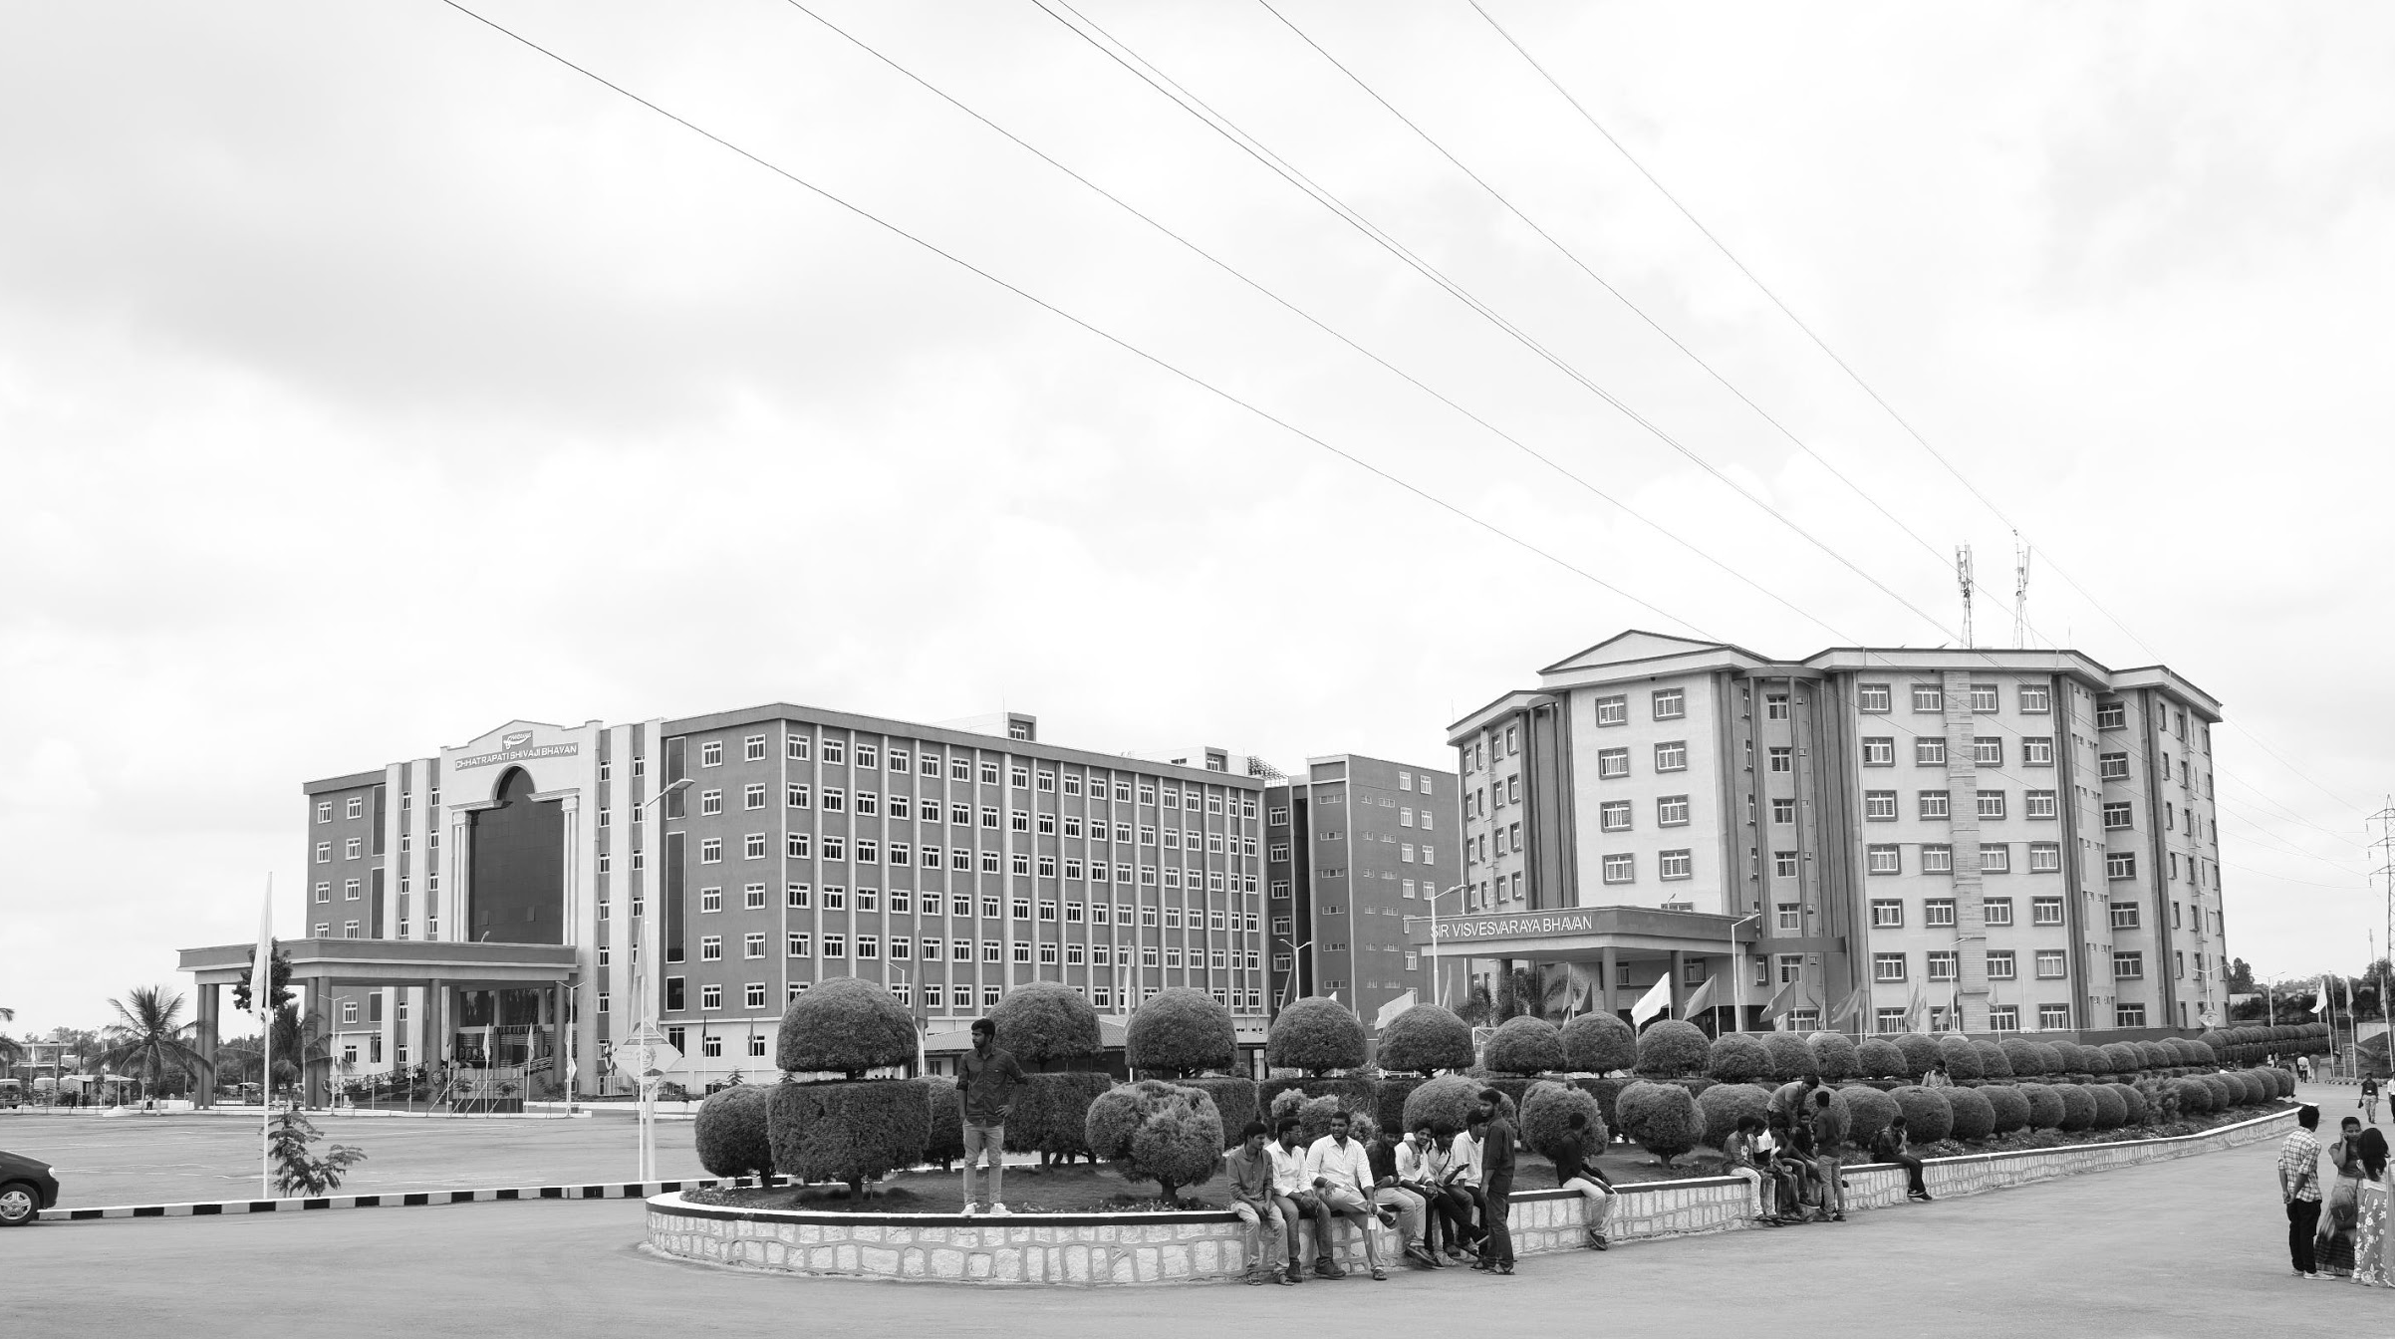

Low Light Image Enhancement Using Homomorphic Filtering Approach
AY 2021-25
GITAM UNIVERSITY
Major Project
Project ID: CS9
A University should be a place of light, of liberty, and of learning.
Department of Electrical Electronics and Communication Engineering
Project Team:
Mohammed Ashraf Razvi
Shaik Kashida Jabeen
Avva Praveen Babu
Project Mentor:
Pankaj Kandhway
www.gitamedu.com

Slide 2

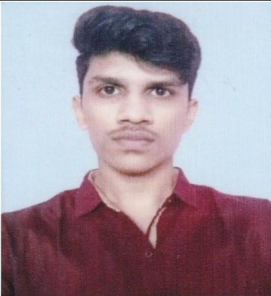

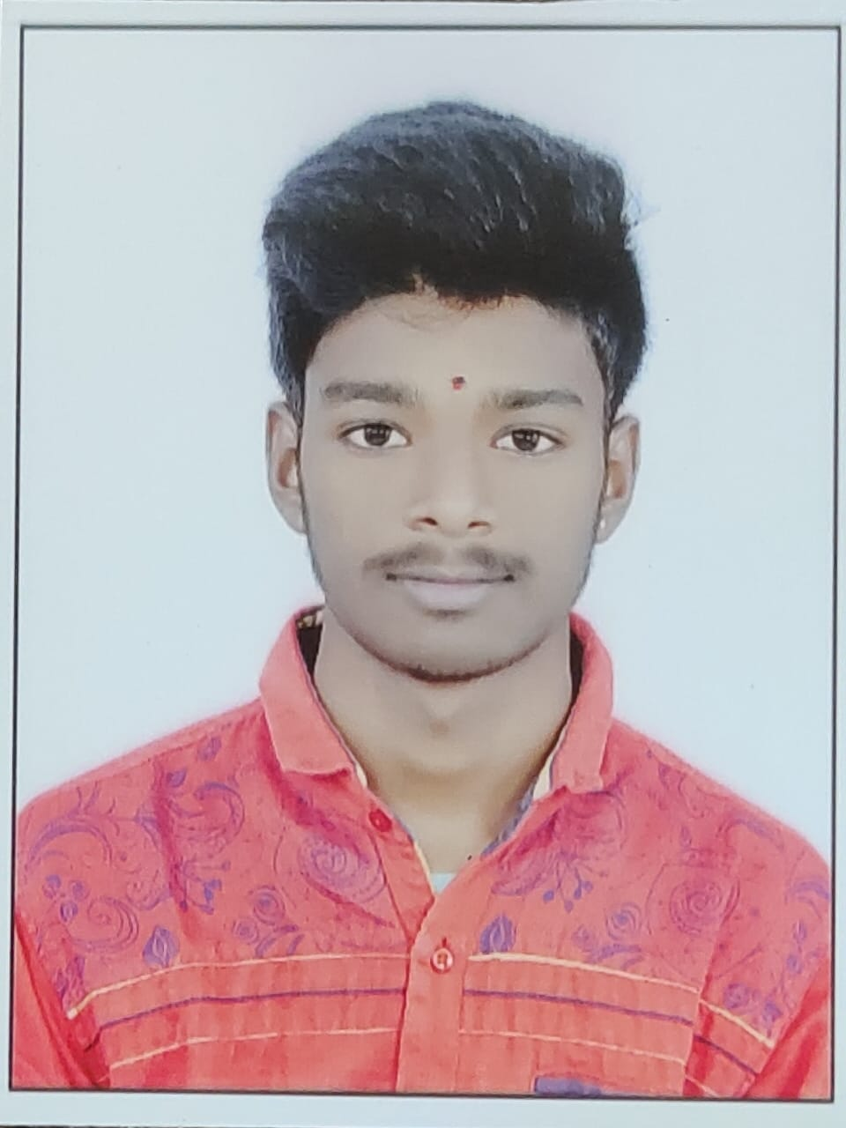
Project Group – Details
Photo
Track
Roll No
Name
EECE
BU21EECE0100149
MOHAMMED ASHRAF RAZVI
EECE
BU21EECE0100512
SHAIK KASHIDA JABEEN
EECE
BU21EECE0100527
AVVA PRAVEEN BABU

Slide 3
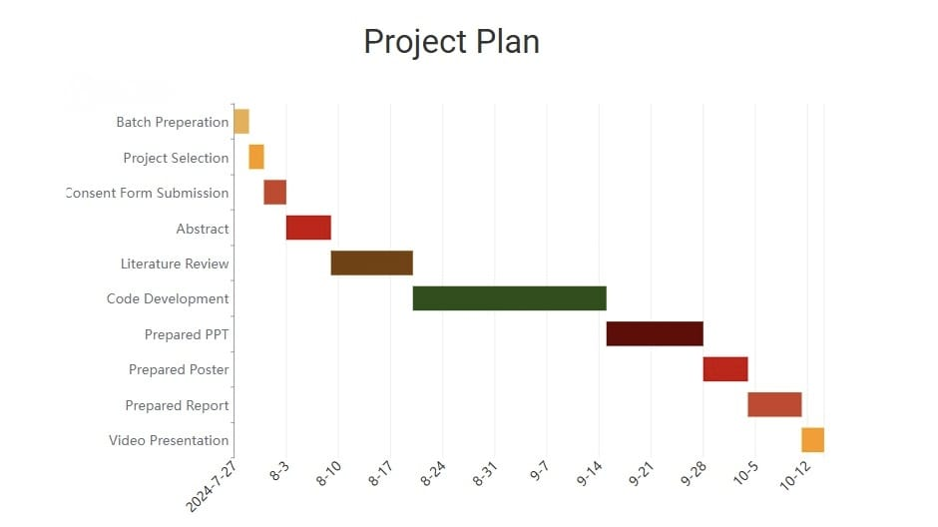

Slide 4
Objective and Goals
Objective
Brief Description:
Low-illumination images are typically taken in environments with limited light and may be affected by fluctuating lighting from sources like bright lights or bulbs.
Previous enhancement methods often result in halo artifacts, unnatural colours, and loss of information.
Retinex theory, which applies a homomorphic light filtering approach, assumes the incident component can be obtained using a Gaussian technique, based on primary ambient light.
Atmospheric scattering attenuation rate is adjusted according to information loss constraints.
A weighted guided filter is used to refine two parameters and reduce halo block effects.
Goals
Main Goals :
Use of Retinex theory to improve image.
Increase illuminance of low light images.
Additional Goals:
Learning programming in MATLAB
Use of algorithms, Fourier transforms for image enhancement.

Slide 5
Abstract
Low illumination images are usually captured in low light conditions which are often subjected to inconsistent environmental lighting which may include overly bright light or artificial light. The enhancement result obtained by existing techniques are prone to halo artifacts, colour unnaturalness, and information loss. To solve these problems, an algorithm represents a physical lighting model that describes the degradation of poor illumination images. In this model, the environment light is a point wise variable and changes with the local light source as long as the parameters in the model are effectively estimated the low illumination images can be directly recovered by solving the model. In Retinex theory, the initial environmental light is considered to obtain the incident component using Gaussian approach. Secondly, the environmental light scattering attenuation rate is adjusted with the information laws constant. Finally, to restrain the halo block effects, the two parameters are refined by the weighted guided filter. The experimental results indicate the algorithm can improve low illumination images that are captured in different scenes, this increases richness of visible edges and reproduces the colour quality and naturalness.​

Slide 6
Ref No.​ | Title of paper​ | Year | Author | Key Findings | Research gap​
1. | "Readability Enhancement of Displayed Images Under Ambient Light." | 2018,July. | Haonan Su, Cheolkon Jung, Member, IEEE, Shuyao Wang and Yuanjia Du. | Image quality in mobile displays is considerably influenced by ambient light. In the daylight condition, images on mobile displays are darkly perceived by the human visual system due to the limited dynamic range of display, which causes loss of luminance and details. In this paper, we propose readability enhancement of displayed images under ambient light by enhancing both luminance and details. | Exploration of the broader applicability of this framework to different types of displays beyond mobile screens, such as larger displays used in outdoor billboards or automotive screens, where ambient light conditions and viewing distances vary significantly.
2​. | ​"Structure-Revealing Low-Light Image Enhancement Via Robust Retinex Model." | 2018,June. | Mading Li, Jiaying Liu , Senior Member, IEEE, Wenhan Yang, Xiaoyan Sun, Senior Member, IEEE, and Zongming Guo, Member, IEEE | The method involves decomposing the image into reflectance and illumination components and then adjusting the illumination to enhance the image. RRM it ensures that noise is handled appropriately during this process. | Traditional methods based on the Retinex model do not account for the noise inherent in low-light images, often leading to suboptimal enhancement results where noise is amplified or details are lost. Additionally, the use of logarithmic transformations in these methods can exacerbate the issue.

Slide 7
Ref No. | Title of paper | Year | Author | Key Findings | Research gap
3. | Low-Illumination Image Enhancement Algorithm Based On a Physical Lighting Model. | JANUARY 2019 | Shun-Yuan Yu and Hong Zhu | The paper proposes a novel physical lighting model that accounts for the degradation of low-illumination images. This model considers environmental light as a point-wise variable that changes with the local light source. | This paper seeks to bridge these gaps by proposing a physical lighting model that adapts to the variable lighting conditions of low-light environments, aiming to enhance image quality without introducing unwanted artifacts and maintaining accurate color reproduction.
 | ​

Slide 8
Literature Survey
Key Publications
Research paper 1
Research paper 2
Research paper 3
Key Resources – Whitepaper| Application Notes | Datasheet| Others
Google Scholar.
IEEE
Existing Implementations – Products| Opensource| GitHub etc
MATLAB.
Github

Slide 9
Analysis - SWOT
Strengths
Weaknesses
W1. Complexity
W2. Color Distortion
W3. Edge Artifacts
S1. Low light Image enhancement
S2. Noise Reduction
S3. Detail Preservation
Threats
T1. Spatial Temporal Noise.
T2. When dealing with videos mean variation occurs.
Opportunities
O1. Real Time Implementation

Slide 10
Retinex Model:
Retinex model is an image processing technique used primarily for image enhancement. It is particularly effective in improving images captured under low-light conditions. The method operates by transforming an image into the frequency domain, where the image's illumination and reflectance components can be separately manipulated.
Applications:
Low-Light Image Enhancement: Improves visibility and detail in images captured under poor lighting conditions.
Medical Imaging: Enhances features in medical scans, aiding in diagnosis.
Remote Sensing: Enhances satellite images for better analysis and interpretation.

Slide 11
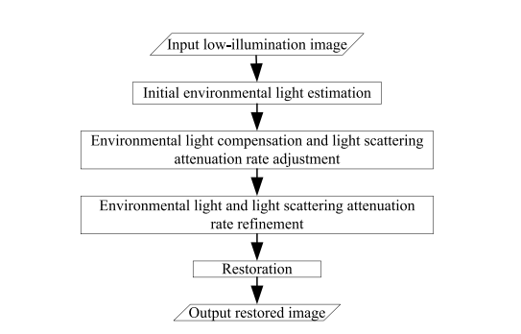
Architecture:
Low Illumination Image Enhancement Algorithm

Slide 12
Use Cases & Testing
Use Cases
Night Vision Systems: The algorithm can be implemented in night vision cameras to enhance images captured in low-light environments, such as military surveillance, wildlife monitoring, or nighttime security operations.
Outdoor Surveillance: In public safety and security, cameras in outdoor settings often face non-uniform illumination conditions. The algorithm helps enhance low-light surveillance footage, enabling clearer identification of individuals, vehicles, and events, even in shadowed or dimly lit areas.
Medical Imaging: Low-illumination conditions are common in some medical imaging scenarios, such as endoscopy or low-exposure X-ray scans. The algorithm could be used to improve image quality without increasing exposure, reducing the risk of damaging sensitive tissues.
Test Cases
Qualitative Testing: Different images, such as night scenes, shadowed areas, and backlit environments, were used to assess the algorithm’s ability to enhance image details while maintaining natural colour. The proposed method was shown to improve contrast and reduce noise while avoiding common issues like halo effects and over-enhancement.
Quantitative Testing: Objective measures like edge visibility, gradient ratios, and information loss thresholds were calculated. The algorithm consistently outperformed others by enhancing low-light details without introducing noise or distorting colour.

Slide 13
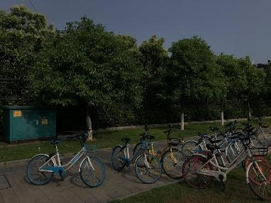
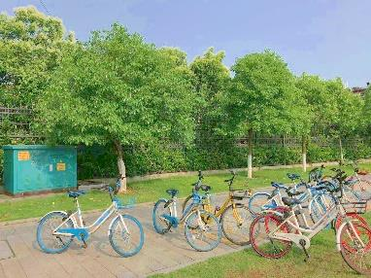
Implementation and Results – Iteration 1
Iteration 1 : Results

Slide 14
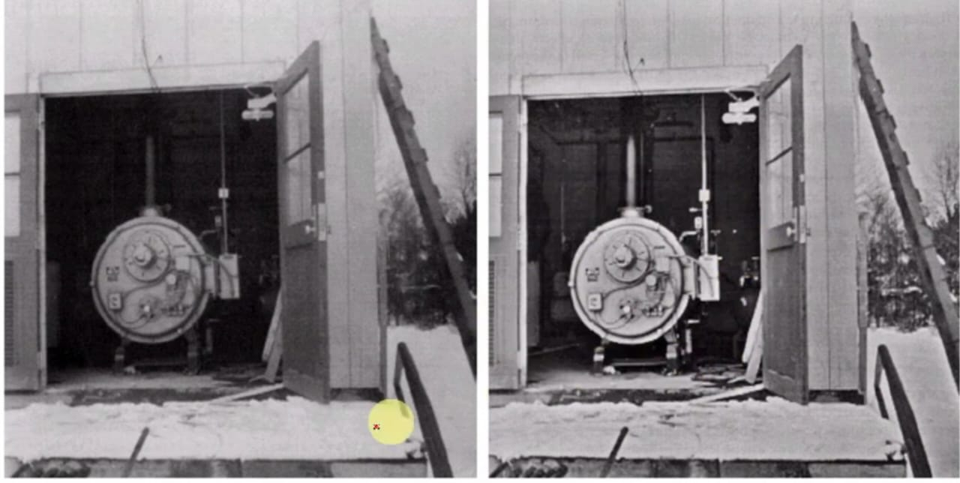
Implementation and Results – Iteration 2

Slide 15
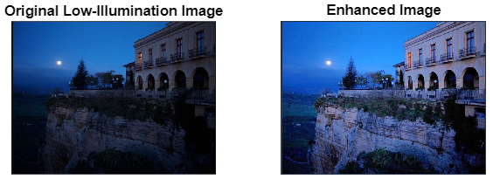

Slide 16
Contribution
Team Progress and Movement
Initial Planning and Role Assignment: Individual roles were assigned based on expertise. For instance, some members focused on code development, while others handled testing, analysis, and documentation.
Research and Development Phase: Team members surveyed different research papers and explored different methods to address the problem.
Iterative Improvements and Problem Solving: The team faced challenges getting the clear details of image so we have addressed it by minimizing artifacts for example halo effects and over enhancement.
Collaboration and Cross-Functionality: Team members worked together across different roles, such as how the testing team provided feedback to the code developers, or how insights from the literature review informed adjustments in the model.
Milestone Achievements: After performing the code on various datasets the code gave significant enhancements in the images.
Individual Contribution
Key contributions: Mohammed Ashraf
Responsible for developing the code and implementation of Retinex theory and Gaussian filters.
Handled the testing of various datasets.
Key contributions: Shaik Kashida Jabeen
Contributed to the literature review and theoretical framework, providing analysis of existing enhancement theories.
Took part in code development
Key contributions: Avva Praveen Babu
Gathered the datasets of various low light images.
Handled evaluations and compared the performance against other models.
(All team members contributed equally)

Slide 17
Conclusion & Future Work
Summary and Conclusion
The development of the Low-Illumination Image Enhancement Algorithm Based on Retinex Theory marks a significant advancement in the field of low-light image processing. By addressing the inherent challenges of enhancing images captured in poorly lit environments, the algorithm demonstrates superior performance compared to traditional methods and existing literature. In conclusion, this project provides a valuable contribution to the field of image enhancement by presenting a comprehensive approach that combines retinex model with iterative refinement. The results not only advance the understanding of low-light image processing but also pave the way for future innovations in this area.
Future Work
Integration with Deep Learning Techniques: Future research could explore the combination of the physical lighting model with deep learning approaches to enhance computational efficiency and effectiveness. Using convolutional neural networks (CNNs) could automate the process of parameter estimation and improve the algorithm's adaptability to various low-light conditions.
Real-Time Processing Capabilities: Further development could focus on optimizing the algorithm for real-time applications. Techniques such as model pruning, quantization, or utilizing efficient hardware (like GPUs or specialized accelerators) could be explored to reduce computational overhead while maintaining performance.

Slide 18

THANK YOU

